Slide 1
Visual Document Understanding
Hierarchical Table Extraction & Business Insights
Advanced Computer Vision for Deep Learning — Final Project
Team Members:
Lawrence Lin
Ryan Chen
Kacey Zhu
Jared Maksoud

Slide 2
Presentation Outline
01
Problem Statement
05
Error Analysis
Why hierarchical table extraction is hard
Where and why each model fails
02
Dataset & EDA
06
TableSight Dashboard
FinTabNet: 32,670 financial tables analyzed
Deployment & demo interface
03
Pipeline & Models
07
Conclusions
TSR → HTML → KIE → Structured Records
Key findings & hybrid architecture recommendation
04
Results & Comparison
Skeleton TEDS, Pipeline TEDS, F1 across 5 systems

Slide 3
Problem Statement
The Challenge
End-to-End Pipeline
Financial documents contain tables with:
Multi-level headers & merged cells
Irregular layouts (wide, tall, borderless)
Low contrast & poor scan quality
Traditional OCR extracts text but loses the logical table structure, making downstream analytics impossible.
1 Document Image
2 Table Structure Recognition (TSR) → HTML Structure
3 HTML → DataFrame
4 Key Information Extraction (KIE) → Business Records

Slide 4
Dataset: FinTabNet EDA — Overview & Distribution
32,670
850
150
300
Total Records
Train split
Validation split
Test split
Image Type Distribution
Avg Hard Score by Image Type
Key finding: Wide tables dominate the dataset (48.6%), but tall tables score hardest (avg difficulty 29). Image type — not image quality — is the primary difficulty axis, driving our stratified sampling strategy.

Slide 5
Dataset: FinTabNet EDA — Structural Complexity
Key Correlations
Structural Feature Ranges
Span Distribution
r = 0.91
Feature | Range | Mean / Median | Implication
num_rows | 2 – 83 | Mean 15.1 | Long sequences → truncation risk
num_cells | 4 – 963 | Mean 75.1 | Dense tables amplify alignment errors
max_colspan | 1 – 25 | Median 3 | Grouped headers universal
max_rowspan | 1 – 9 | Median 1 | Rare but disrupts row hierarchy
aspect_ratio | 0.38 – 21.4 | Median 2.93 | Wide layout = compressed columns
colspan > 1
Taller image = more rows = harder
98.1%
r = 0.87
of all tables
Row count drives difficulty score
Most = 2 or 3
r = 0.85
rowspan > 1
Dense tables more error-prone
6.5%
r ≈ 0
Image quality barely matters
of all tables
Critical for row hierarchy
r ≈ 0
Low contrast not the bottleneck
Key finding: Structural complexity — merged headers (98.1% colspan), row count, and cell density — is the core challenge. Image quality is largely irrelevant. Structure-aware metrics (TEDS) and hard examples are both essential for fair evaluation.

Slide 6




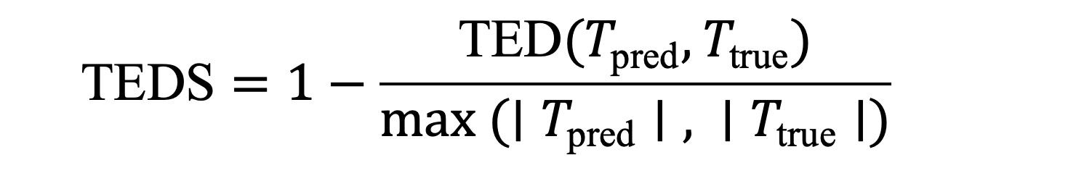


Dataset & Evaluation
Sampling
Data Splits
Stratified sampling from hard examples · 260 images × 5 table types (wide, tall, low-contrast, normal, low-quality)
850
150
300
Train
Val
Test
Preprocessing
Standardize images to consistent resolution & format
Clean HTML annotations — remove redundant tags
Filter corrupted or incomplete samples
Validate image–HTML pair alignment & consistency
TEDS — Tree Edit Distance Similarity
Score 0–1 where 1.0 = perfect match. Structural errors (tag, colspan, rowspan) cost 1.0; content mismatches cost 0.5. Normalized by tree size — penalizes errors proportionally. Evaluated in two modes: Skeleton TEDS (structure only) and Pipeline TEDS (full output).
Augmentation
Training only
Small-angle rotations: simulate scanning misalignment
Scaling: handle resolution variability
Contrast adjustment: model lighting differences
Blur simulation: mimic low-quality / noisy document images
KIE — Key Information Extraction
Evaluated via entity-level F1 — measures correctness and completeness of extracted structured information.

Slide 7
Model Architectures Overview
UniTable
Florence-2
SPARTAN
[Trainable]
[Trainable]
[Heuristic CV]
Pixel-to-text encoder-decoder with ConvStem + Transformer. 3-pass pipeline: structure → bbox → content. LoRA fine-tuned.
Unified vision-language model with prompt-based generation. LoRA fine-tuned for TSR and KIE subtasks.
No trainable weights. Classical CV: adaptive thresholding → OCR clustering → grid reconstruction. CPU-only.
LlamaParse
ChatGPT
[External API]
[External API]
Production document parsing API integrating OCR + layout analysis. Industrial-grade, black-box.
GPT-4o-mini multimodal API. Prompt-based instruction reasoning. Strong semantic adaptability.

Slide 8
Model Performance Results
Model | Skeleton TEDS | Pipeline TEDS | F1 Score
UniTable (Fine-tuned) | 0.8353 ⭐ | 0.3417 | 0.4928
UniTable (Original) | 0.8353 | 0.3389 | 0.4829
SPARTAN | 0.7253 | 0.5391 ⭐ | 0.70 ⭐
Florence-2 (LoRA) | 0.0441 | 0.0287 | N/A
ChatGPT | N/A | 0.5109 | N/A
LlamaParse | N/A | 0.5120 | N/A
⭐ = Best in category among all models

Slide 9

Florence-2: Zero-shot Strength vs Fine-tuning Challenges
Fine-tuning Setup
TEDS Results
Fine-tuned (LoRA)
AdamW
1e-4
LoRA
0.0441
0.0287
Optimizer
LR
Method
Skeleton TEDS
Pipeline TEDS
Epochs: 50 — early stopped at epoch 17 (unstable loss)
Zero-shot baseline — Pipeline TEDS: 0.1539 ▲ outperforms fine-tuned
Why Fine-tuned Underperforms Zero-shot
Subtask Decomposition
Task Mismatch
Direct HTML generation proved too challenging for Florence-2. The task was decomposed into two subtasks:
Florence-2 pre-trained for OCR, captioning & grounding — not HTML generation. Large domain gap makes the task inherently difficult to learn.
Training Instability
TSR
KIE
Cross-entropy loss did not decrease steadily — model likely failed to converge, triggering early stopping at epoch 17 of 50.
HTML Skeleton
Cell Content
LoRA Misconfiguration
Suboptimal rank/alpha may have given the adapter insufficient capacity or destabilized training through excessive parameter updates.

Slide 10
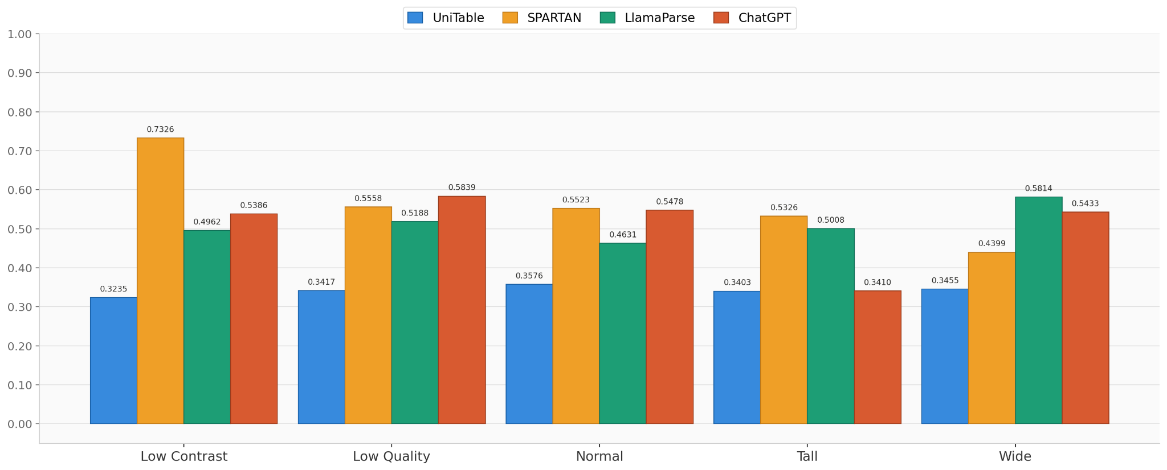
Pipeline TEDS by Image Type
SPARTAN leads on Low Contrast | ChatGPT collapses on Tall tables | LlamaParse most consistent

Slide 11
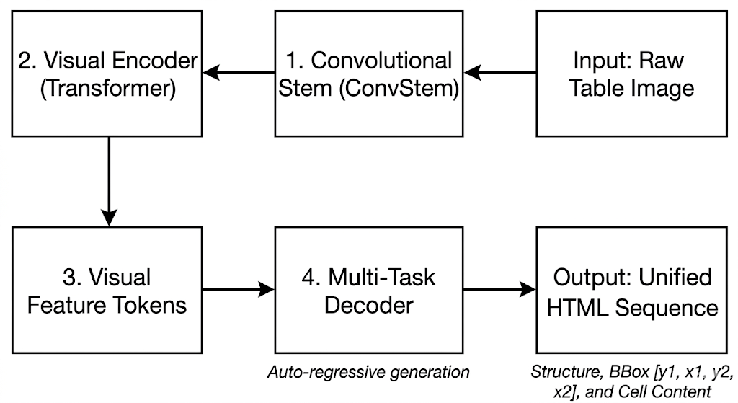
UniTable: Structure and Fine Tune
Pass 1
Structure Model
Pass 2
BBox Model
Pass 3
Content Model
Fine-tuning Setup
HTML skeleton
with [] placeholders
Cell coordinates
[y1, x1, y2, x2]
OCR fills
placeholders
AdamW
Optimizer
5e-5
Vector Quantized -Variational Autoencoder (VQVAE):
Original Embedding s compared to codebook to make the quantized loss minimum.
LR
LoRA
Method
3
Epoch

Slide 12
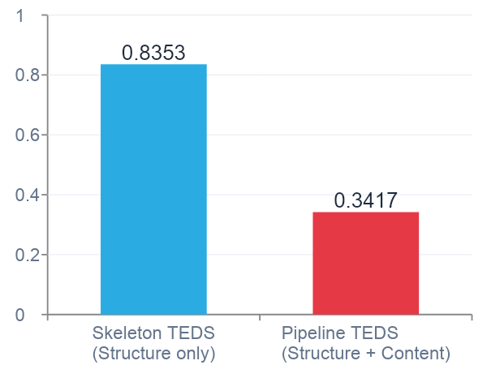
UniTable: Result
Root Cause:
Cascading errors — a single mispredicted structural token shifts every downstream cell.

Slide 13
SPARTAN: The Heuristic Surprise
Skeleton TEDS
Why SPARTAN wins on Pipeline TEDS
UniTable
0.8353
SPARTAN
0.7253
No cascading errors: content is geometrically tied to structure — a wrong row shifts only that word, not the whole table
CPU-only, deterministic: runs in seconds, errors are traceable to OCR or geometry
Best on low contrast: Pipeline TEDS 0.7326 — highest of any model in that category
Weakness — span loss: 54.2% of SPARTAN failures involve lost column spans (multi-level headers)
Pipeline TEDS
UniTable
0.3417
SPARTAN
0.5391
Cell F1
UniTable
0.4928
SPARTAN
0.7
+0.22 mean Pipeline TEDS gap over UniTable across all 5 image types

Slide 14
Error Analysis: Failure Modes
UniTable
Florence-2
Structural token misprediction cascades to all subsequent cells
Hallucinated content tokens corrupt full-row sequence
Sequence length overflow on large tables (truncated decode)
Severe structural oversimplification (predicted skeleton ≈ 2 cells)
Incorrect text placed in wrong cells penalized by TEDS
General VLM not pre-trained for markup generation
SPARTAN
ChatGPT
Span loss: merges grouped header columns (54.2% of failures)
80% of FinTabNet tables are borderless — LSD grid fails
No learning: can't generalize beyond fixed heuristics
Fails completely on tall tables — produces empty outputs
Loses column-span hierarchy in multi-level headers
Dense visual layouts exceed visual encoding capacity

Slide 15
TableSight: Deployment Dashboard
4 Dashboard Tabs
HTML → DataFrame Export
Compare
Single-image inference — upload or pick random from 1,300 gallery images. Models run in parallel, TEDS shown side-by-side.
Parser Input
Model-generated HTML (any model)
colspan expand
Benchmark
Pre-computed aggregate stats over 1,300 samples, broken down by image_type and difficulty.
Repeat header across spanned columns
rowspan carry
Batch Eval
Run all models over uploaded CSV slice, export per-sample scores.
Carry merged cells into following rows
Pad short rows
Normalize to rectangular shape
Failure Analysis
Surfaces all samples with TEDS < 0.5 with diff vs ground truth.
Download CSV
1,495/1,510 complex samples: clean parse

Slide 16
Key Findings
1
Structure ≠ Content
Best structure model (UniTable, 0.8353) ≠ best content model (SPARTAN, 0.5391 Pipeline TEDS). Optimize separately.
2
Cascading Errors Dominate
Multi-stage pipelines amplify small mistakes. SPARTAN's local error confinement beats UniTable's global decode despite weaker structure.

Slide 17
Future Work & Recommendations
Direction 1: Fine-Tuning UniTable with more epochs and higher learning rate.
Fine-tune the content model using more epochs, higher learning rate and increase the impact of LoRA.
Direction 2: Learned Row-Grouping Classifier
Replace SPARTAN's fixed row_tol_frac threshold with a learned classifier. Directly attacks span loss (54.2% of failures) without hurting multi-line wrapped layouts.
Direction 3: Hybrid Architecture
Recommended: UniTable skeleton + SPARTAN OCR + parsing layer. Compose model strengths rather than demanding one model own the whole pipeline.

